Slide 1
Department of Statistics
Travel Trends:
HOW Do Americans Get Where They’re Going?
Presenters:
Brianna Lawton, Zhiyi Zheng, Mariana Chiozza,
Amrita Goswamy, and Waruni Wijayasinghe

Slide 2
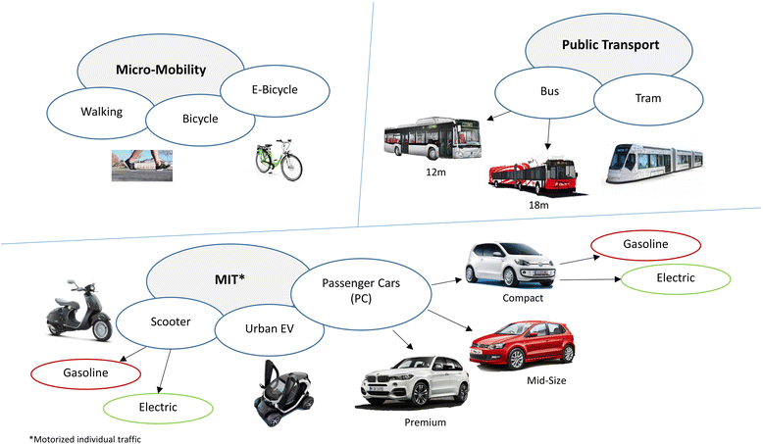
Introduction
Notes:
There are various modes of transportation available for the American population to use.
The U.S. department of transportation describes the basic five modes of transport to be: rail, water, road, air, and pipeline.
Under each of these five modes, there is a further breakdown of transportation modes.

Slide 3
Data Source
2017 National Household Travel Survey (NHTS)
4 data files
household [129,696:58];vehicle; person; trip
Variables used
HouseID: Household Identifier
HHSTATE: Household State
HHFAMINC: Household Income
HHSIZE: Count of household members
TRAVDAY: Travel day - day of week
URBRUR: Household in urban/rural area
CAR: Frequency of Personal Vehicle Use for Travel
TAXI: Frequency of Taxi Service or Rideshare Use for Travel
BUS: Frequency of Bus Use for Travel
TRAIN: Frequency of Train Use for Travel
BIKE: Frequency of Bicycle Use for Travel
WALK: Frequency of Walking for Travel
PARA: Frequency of Paratransit Use for Travel
Notes:
NHTS aka National Household Travel Survey is a the source of the Nation’s information about travel by U.S. residents in all 50 States and Washington, DC. It provides information to assist transportation planners and policymakers who need comprehensive data on travel and transportation patterns in the United States.
The survey consists of 4 data files.
For this project we looked into the household data which gave us information about a household’s characteristics.
Within the household dataset, the following variables were used to run analysis and produce results for this project.

Slide 4
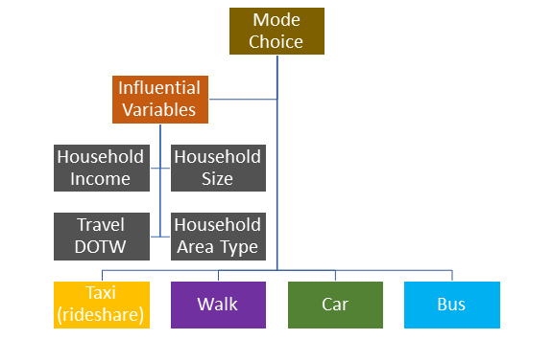
Objective
Identify different modes of travel available in the U.S.
Identify variables that could potentially influence mode choice
Explore trends between a particular mode and influential variables
Notes:
Looking into mode choice is important because it can help:
identify what modes are being heavily utilized, which can help decide where to direct funds to maintain transportation infrastructure
identify where to implement measurements to reduce traffic congestion, which then reduces travel time, which in return can reduce travelers costs and vehicle emissions

Slide 5
Methodology
Literature Review
Data Cleaning
filter data to subset of variables needed to perform analysis
Data Analysis
Used the tidyverse package
Removed NAs
Reordered levels and changed level names
Converted variables from numeric to characters
Created new variables (mutate function)
Summarised new dataset
Visualized results with graphs (ggplot package)

Slide 6
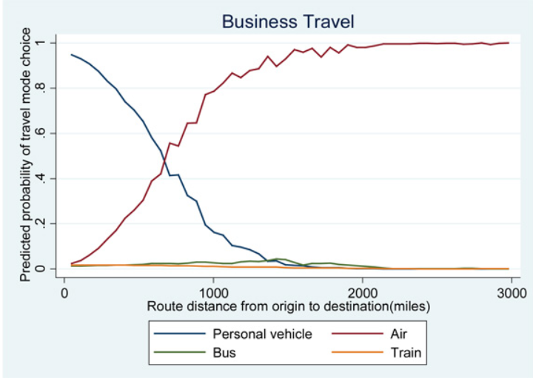
Literature Review
Personal vehicle (car) is the predominant mode for all travelers. (BTS, 2006)
Rural areas use it for 95% of long-distance trips, while personal vehicle (car) is used for only 87% of trips originating in urban areas. (BTS, 2006)
Similarly, 1% use rail from urban areas, compared to about one-half of 1 percent in rural areas. (BTS, 2006)
Mode choice varies by trip purpose, household income, demographics, population per sq. mi. etc. (FHWA)
Notes:
The Bureau of Transportation Statistics shows that the use of personal vehicle (car) is the predominant mode for all travelers. Additionally, rural areas use it for 95 percent of long-distance trips, while personal vehicle (car) is used for only 87 percent of trips originating in urban areas. This may be due to the fact that public transportation and other modes of transportation are available in urban areas. Similarly, 1 percent of travellers use rail from urban areas, compared to about one-half of 1 percent in rural areas. Mode choice also varies by trip purpose, household income, demographics, population per sq. mi., etc.

Slide 7
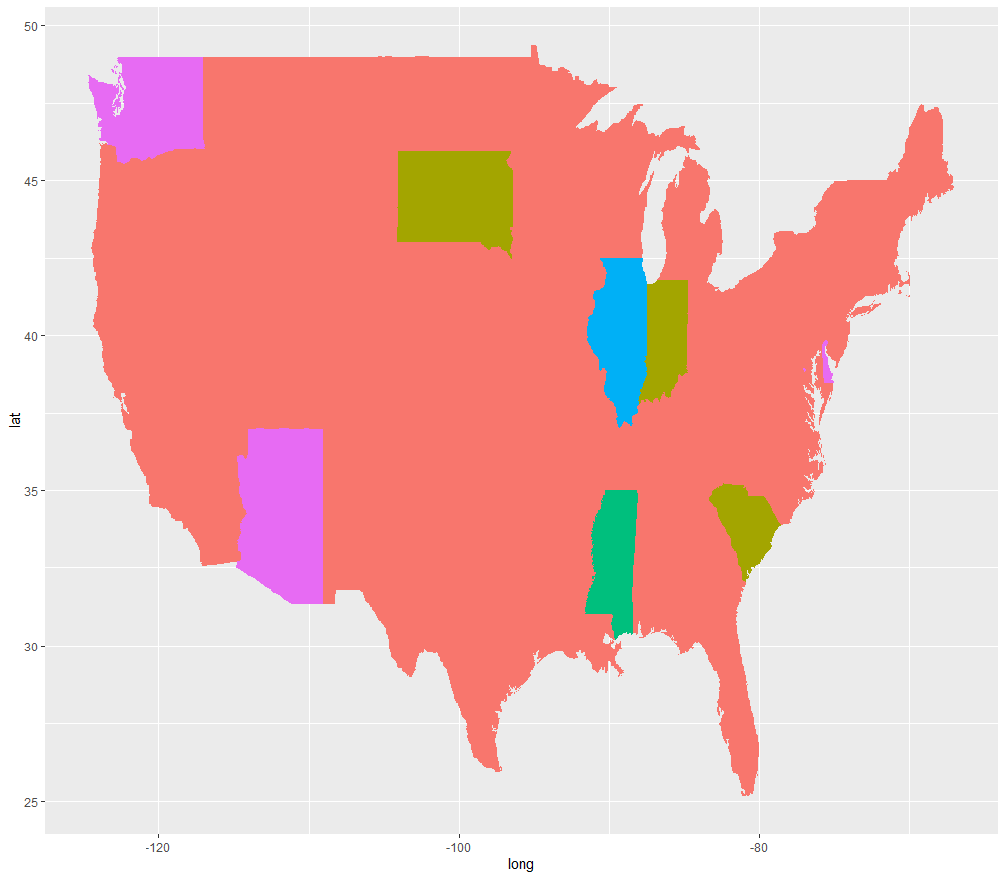
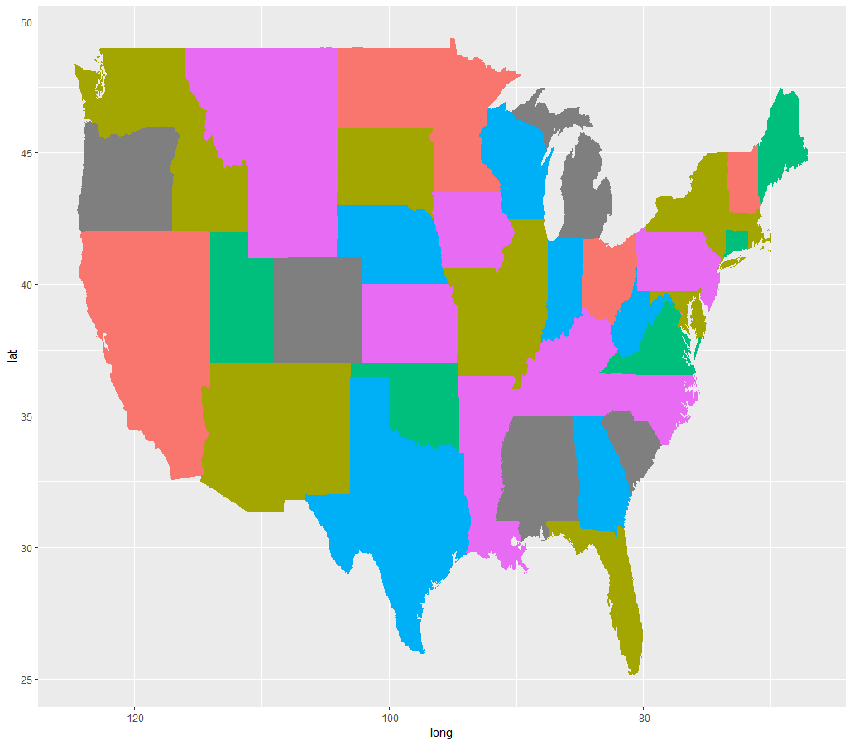
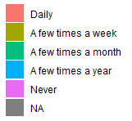
Mode Choice Across the U.S. 2017
CAR
WALK
Notes:
From Choropleth maps some really interesting features can be seen. It can be seen that cars are used daily almost in every state across the united states except for some states like washington where the respondents who were interviewed said they never used cars in 2017. But instead it can be seen that they used bikes more often. Also walking has a good distribution of its levels across the united states. Only a few states showed travellers never walked in 2017 for example Montana and Wyoming.

Slide 8
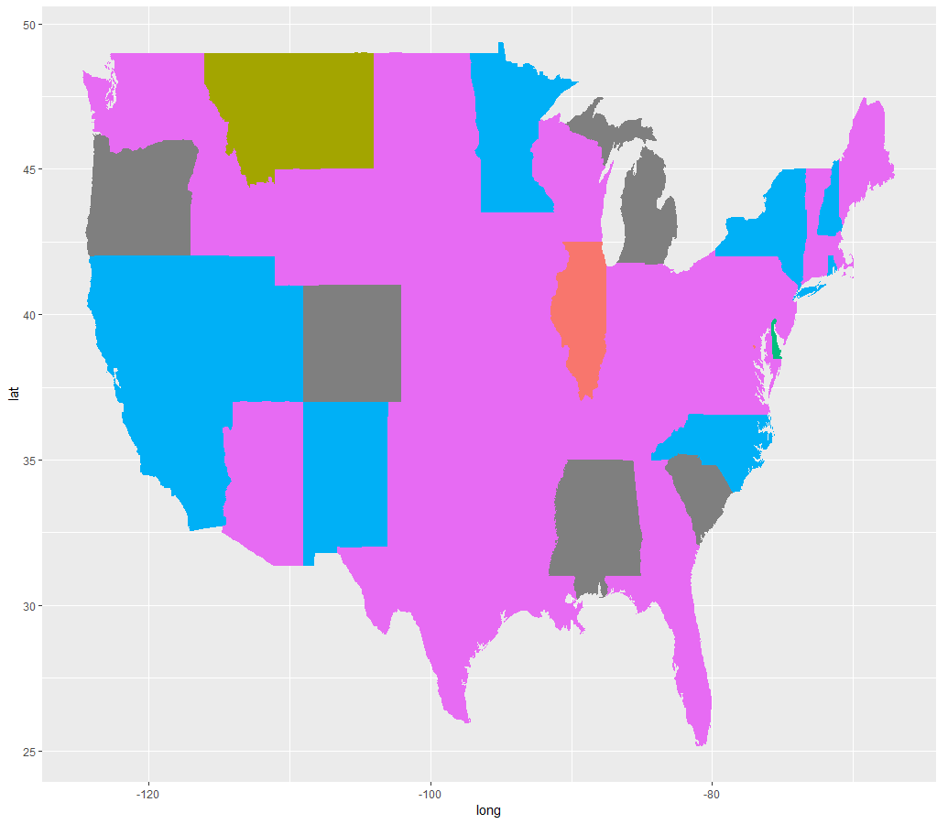
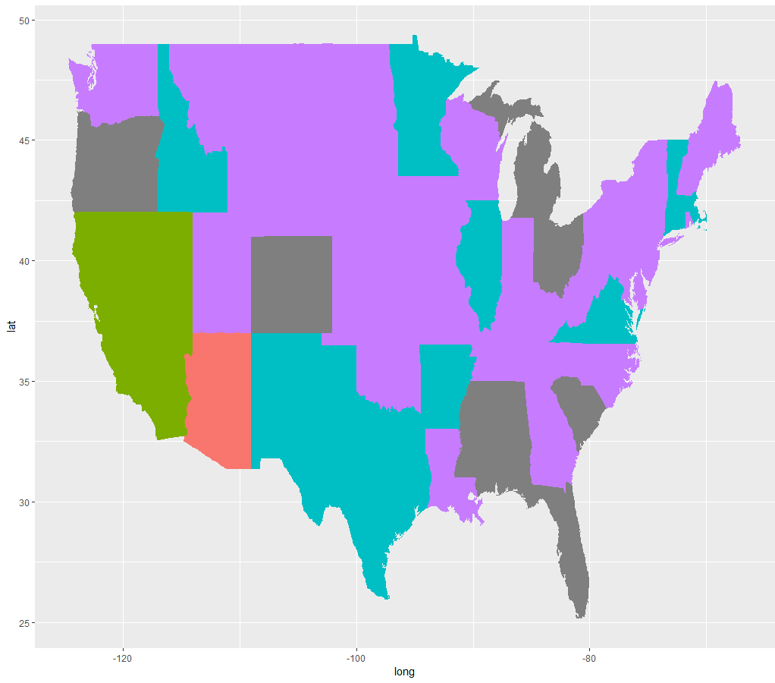
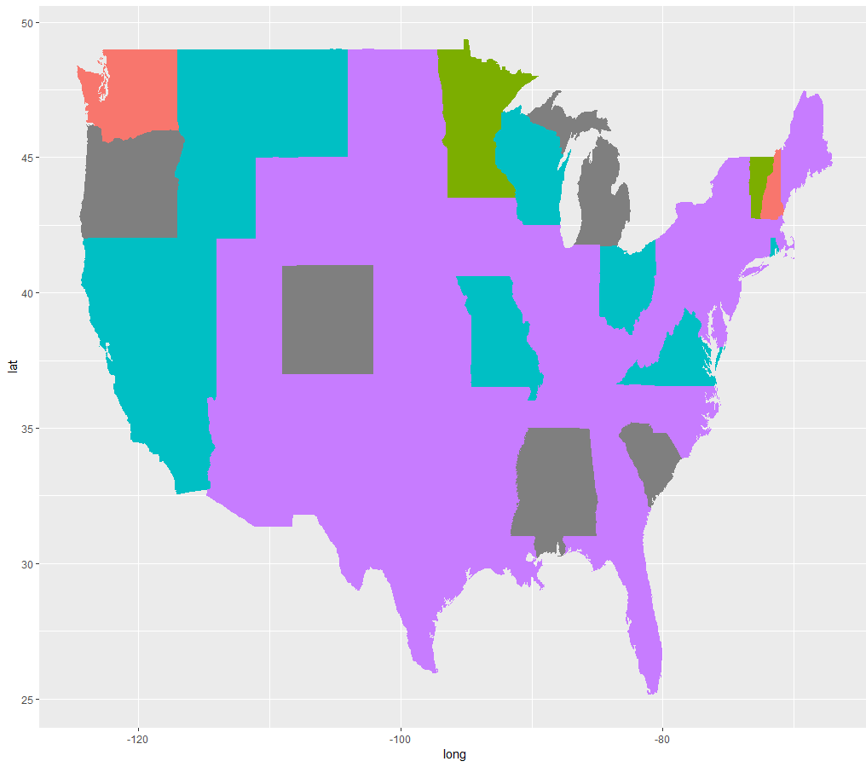
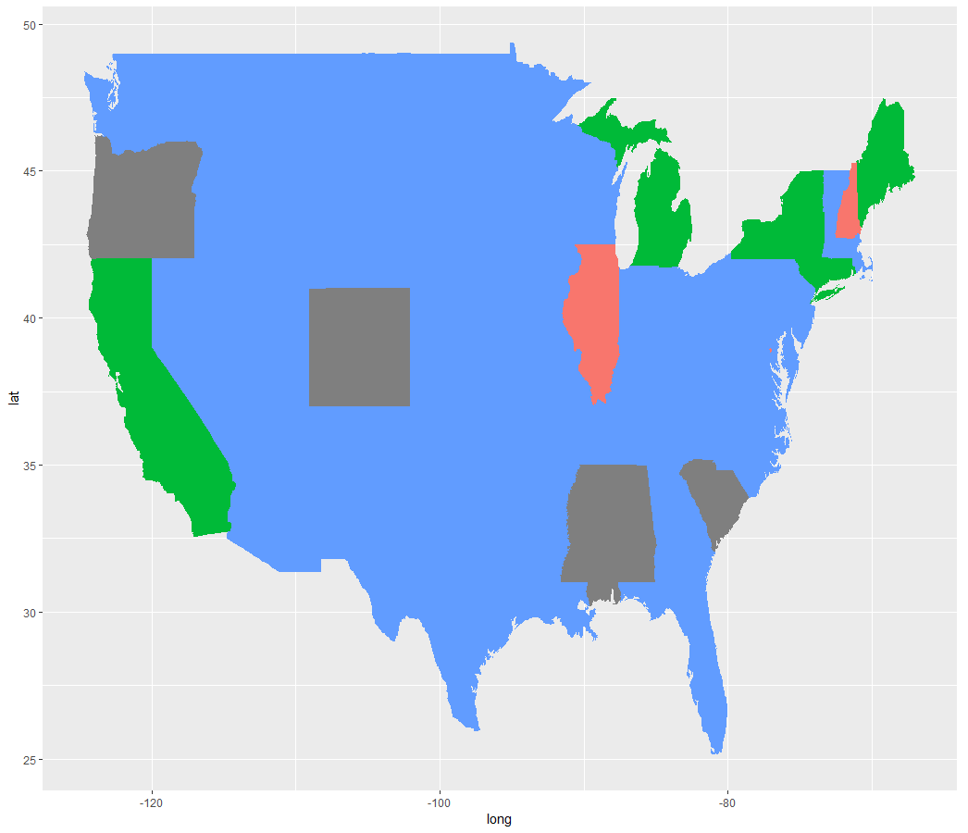
Mode Choice Across the U.S. 2017
BUS
TAXI
BIKE
TRAIN
Notes:
Bus taxi and Bike are almost never used by the majority of the central part of USA. Train is used as a mode a few time a year in majority of the states, except for some few states like Oregon. Also it is used daily in one states that is Illinois.

Slide 9
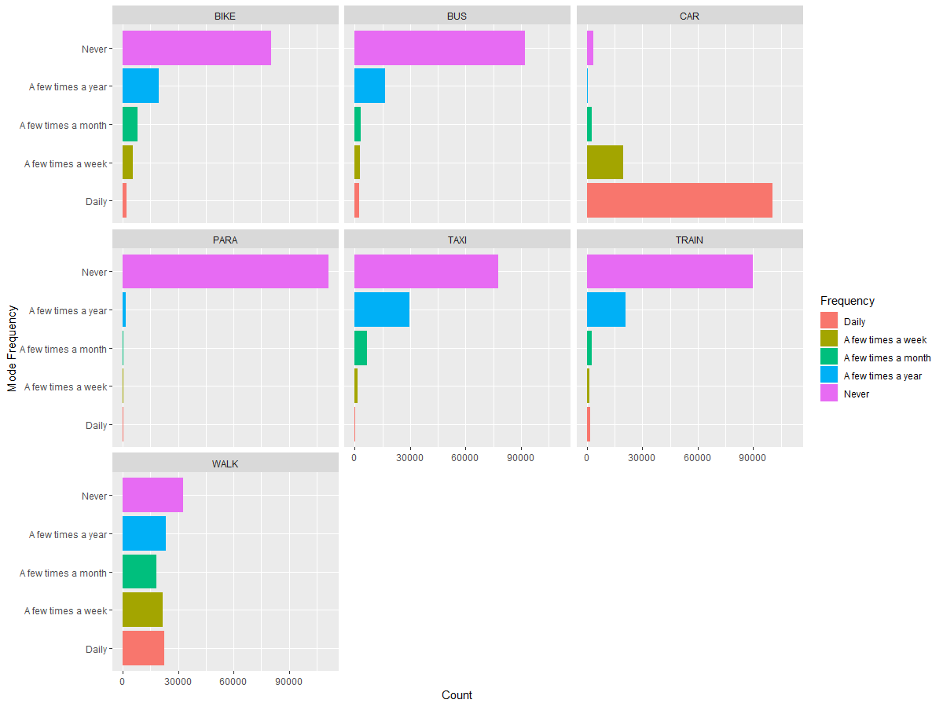
Mode Choice Frequency
Notes:
The following colored bar charts display the frequency of each mode choice given in the dataset. Cars are used daily predominantly followed by walk, bus, bike and train. Taxi is rarely used daily. It was also seen that train, taxi, para, bike, bus were never used by many travellers followed by a lower percentage of walk and car mode.Also walk and car use is above the other modes for people using it a few times a week. Taxi, train, bus, walk and bike have higher respondents for using it a few times a month. As was seen from the maps the walk mode is almost equally distributed among the different levels.

Slide 10
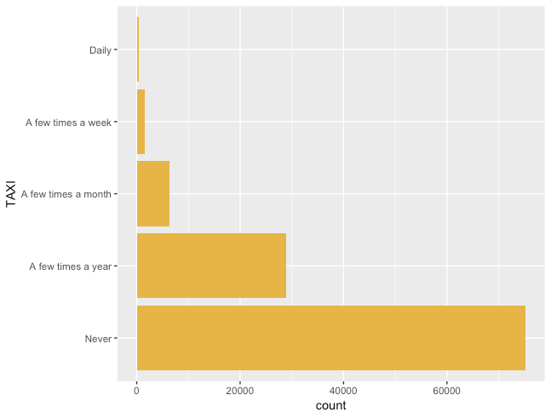
Taxi Frequency Breakdown
Frequency of Taxi | Counts | Proportion
Daily | 343 | 0.305%
A few times a week | 1543 | 1.37%
A few times a month | 6381 | 5.68%
A few times a year | 28971 | 25.8%
Never | 75157 | 66.9%
Notes:
So let’s see the frequency breakdown for each four travel modes seperately.
We have 5 levels for how often people choose that mode for travel, These levels are daily, a few times a week, a few times a month, a few times a year, and never use it .
We counted the total number of respondents in each frequency, also calculated each proportion and included in the table on the left.
To better compare the results, we also made a barchart for each mode on the right side.
The first mode is taxi,
It tells us that more than 70,000 people never chose taxi as a travel mode, which was the predominant one and makes nearly 70% of all.
almost 30,000 people use taxi for travel only for a few times a year.
There was least number of people use taxi daily.

Slide 11
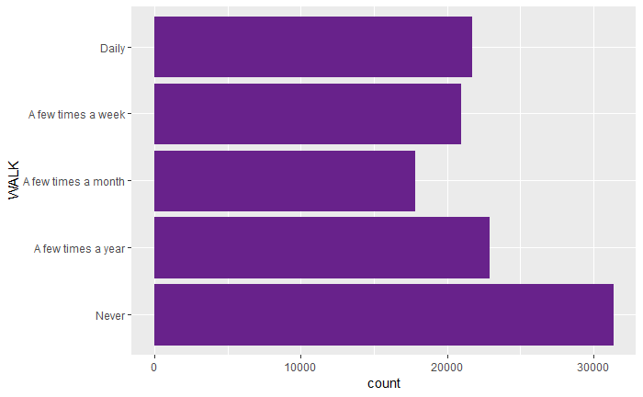
Walk Frequency Breakdown
Frequency of Walk | Counts | Proportion
Daily | 21642 | 18.90%
A few times a week | 20895 | 18.25%
A few times a month | 17755 | 15.51%
A few times a year | 22868 | 19.97%
Never | 31325 | 27.36%
Notes:
Regarding walk as a mode of transportation, we can see that proportions are more evenly distributed between the different frequencies as compared to taxi mode of travel.

Slide 12
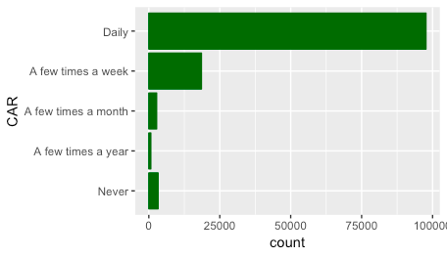
Car Frequency Breakdown
Frequency of CAR | Counts | Proportion
Daily | 97680 | 79.5
A few times a week | 18534 | 15.1
A few times a month | 2750 | 2.24
A few times a year | 700 | 0.570
Never | 3248 | 2.64

Slide 13
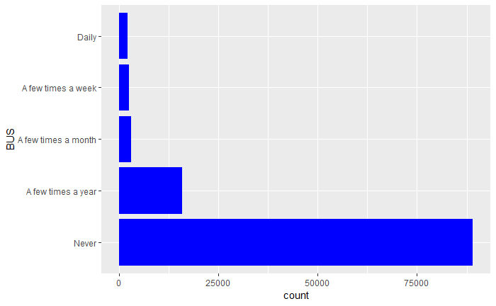
Bus Frequency Breakdown
Frequency of Bus | Counts | Proportion
Daily | 2201 | 1.95
A few times a week | 2565 | 2.27
A few times a month | 3082 | 2.73
A few times a year | 15927 | 14.11
Never | 89045 | 78.92
Notes:
The following bar chart shows the frequency breakdown of bus usage in 2017. We see that about 80% of people use bus as a mode of travel on the daily.

Slide 14
Summary of Analysis & Results

Slide 15
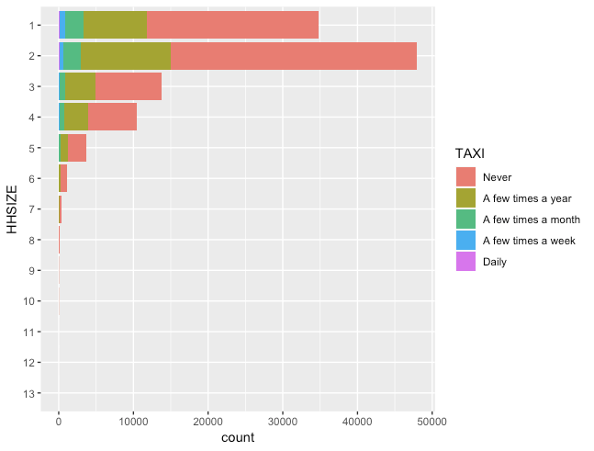
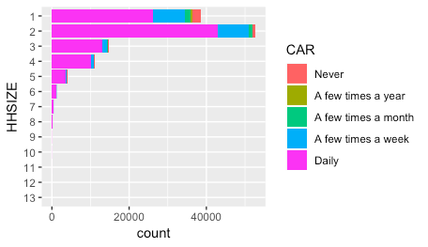
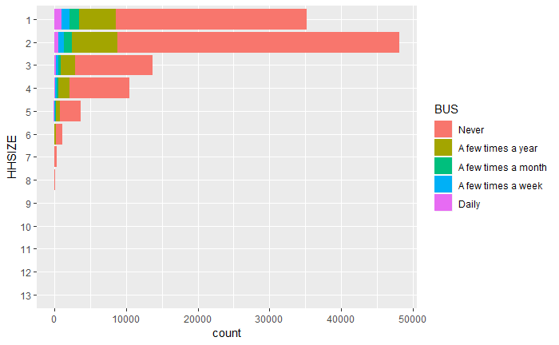
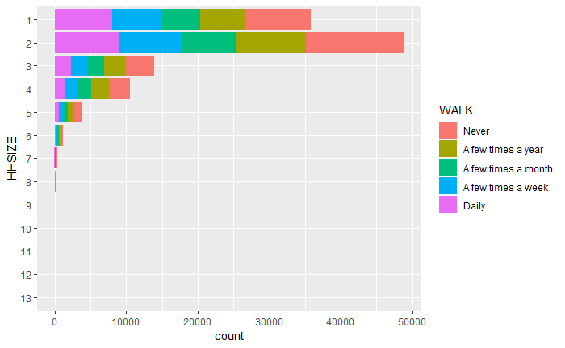
Modes by HH Size

Slide 16
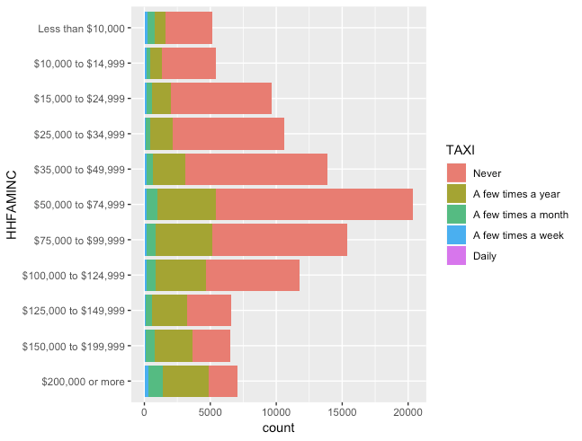
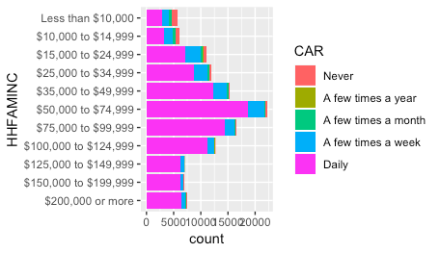
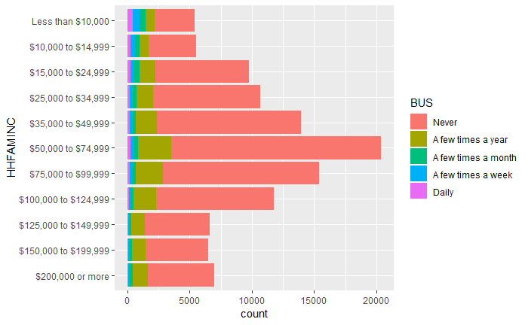
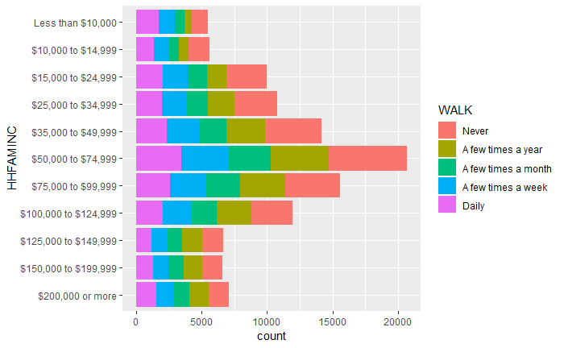
Modes by HH Income

Slide 17
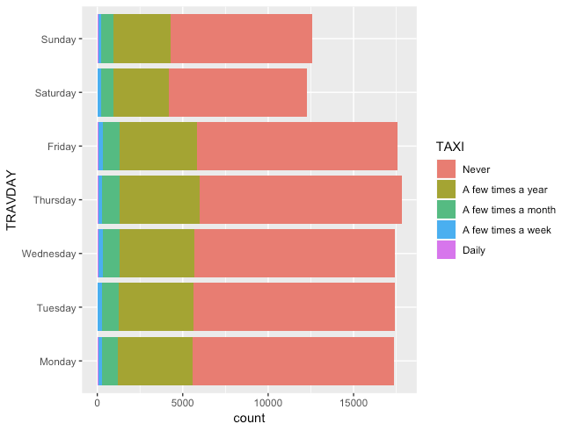
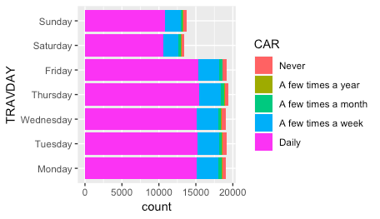
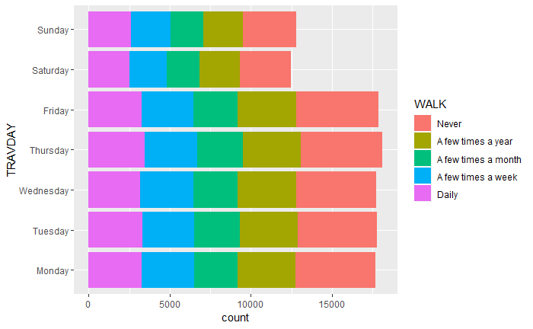
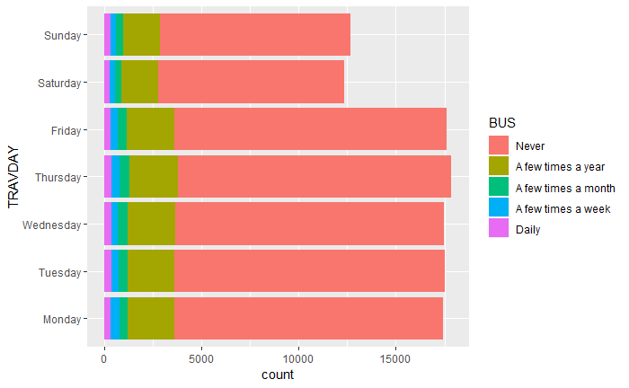
Modes by Travel Day

Slide 18
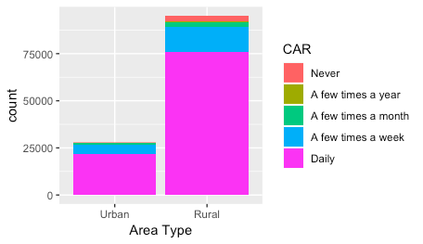
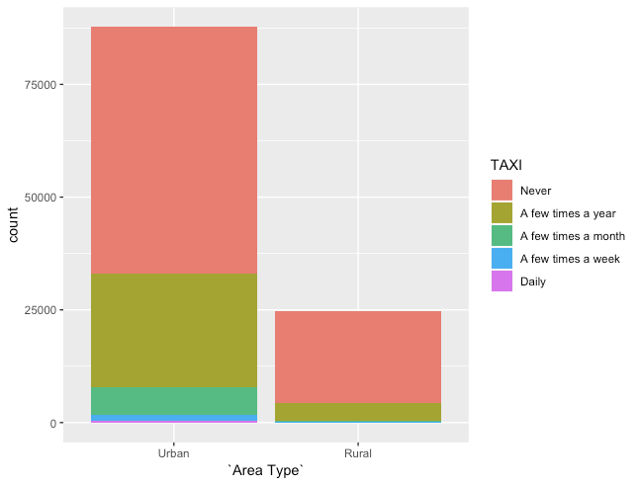
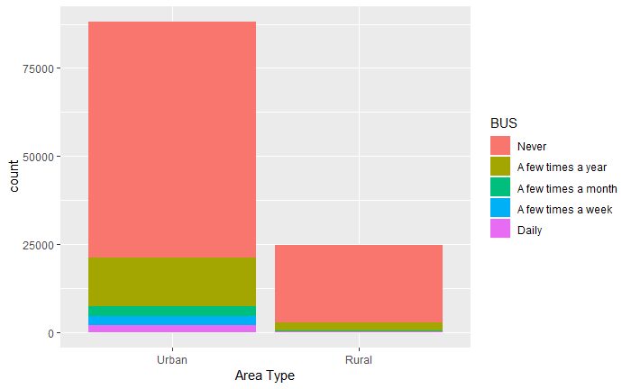
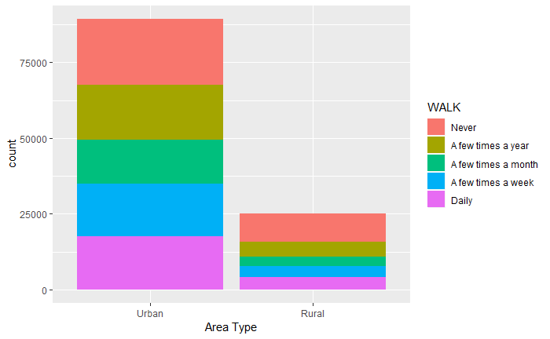
Modes by Area Type
Notes:
When looking at the variable area type versus mode choice

Slide 19
Summary...Future Scope...and Limitations
Frequency of car use is consistently “daily”
Frequency of taxi and bus use is consistently “never”
Frequency of walking is consistently distributed among each variable type
Mode of travel trends showed to be influenced by
- Household size
- Household income
- Travel day
- Area type
Limitations
Variables not present in past recorded dataset (hard to make comparisons)
Future Scope
Interesting response rate
Notes:
NHTS Data not necessarily a good representation of American’s Travel Patterns (see next slide)

Slide 20
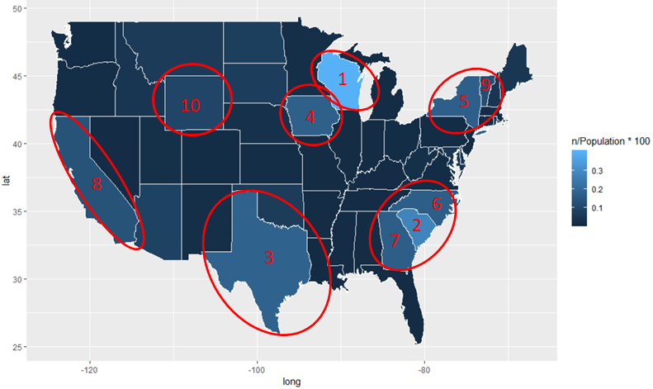
NHTS Response Rate
Notes:
We can observe here data representativeness of the survey to put things on perspective. THe state with more people surveyed from the total people who live in the state, was WI with 0.4 % of the population surveyed. Following WI is SC, with 0.3 % of the population surveyed. We mentioned here the top 10 states with the highest data representativeness.

Slide 21
References
https://www.bts.gov/archive/publications/america_on_the_go/long_distance_transportation_patterns/entire
https://www.fhwa.dot.gov/policy/modalchoice/chap3.cfm
more in the paper

Slide 22
THANK YOU!

