Slide 2
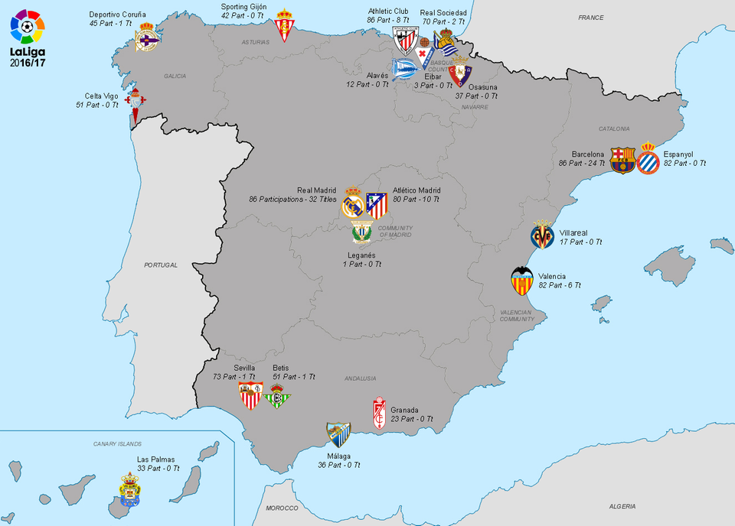
Spain Soccer League

Slide 3
Dataset
20 teams
380 matches per season
9 seasons
24 variables

Slide 4
Questions
1) Which team is ranked 1st (Champion) more times in the last 9 seasons?
2) What is the average total points per season of the Champion?
3) What is the average total points of the Champion after 19 weeks.?

Slide 5
Div = League Division
Date = Match Date (dd/mm/yy)
HomeTeam = Home Team
AwayTeam = Away Team
FTHG= Full Time Home Team Goals
FTAG= Full Time Away Team Goals
FTR= Full Time Result (H=Home Win, D=Draw, A=Away Win)
HTHG = Half Time Home Team Goals
HTAG = Half Time Away Team Goals
HTR = Half Time Result (H=Home Win, D=Draw, A=Away Win)
HS = Home Team Shots
AS = Away Team Shots
HST = Home Team Shots on Target
AST = Away Team Shots on Target
HC = Home Team Corners
AC = Away Team Corners
HF = Home Team Fouls Committed
AF = Away Team Fouls Committed
HY = Home Team Yellow Cards
AY = Away Team Yellow Cards
HR = Home Team Red Cards
AR = Away Team Red Cards

Slide 6
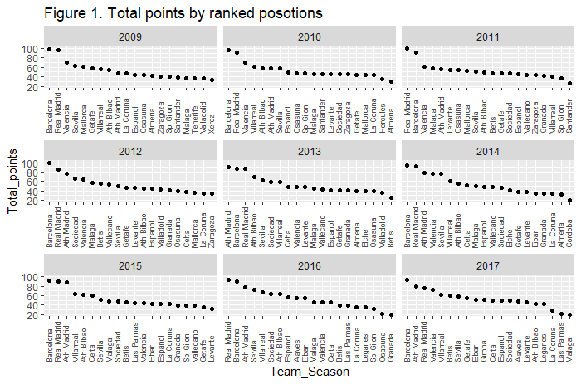

Slide 7
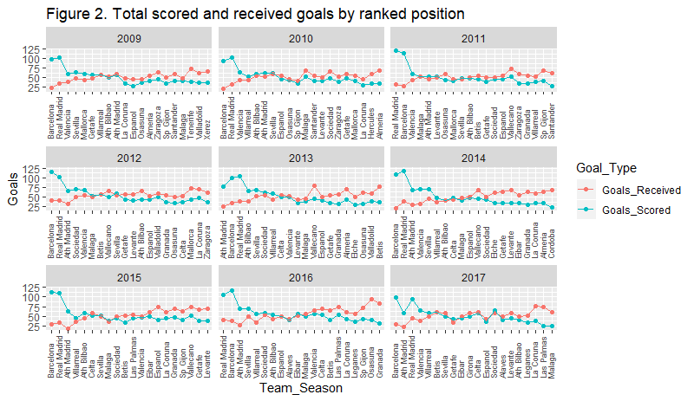

Slide 8
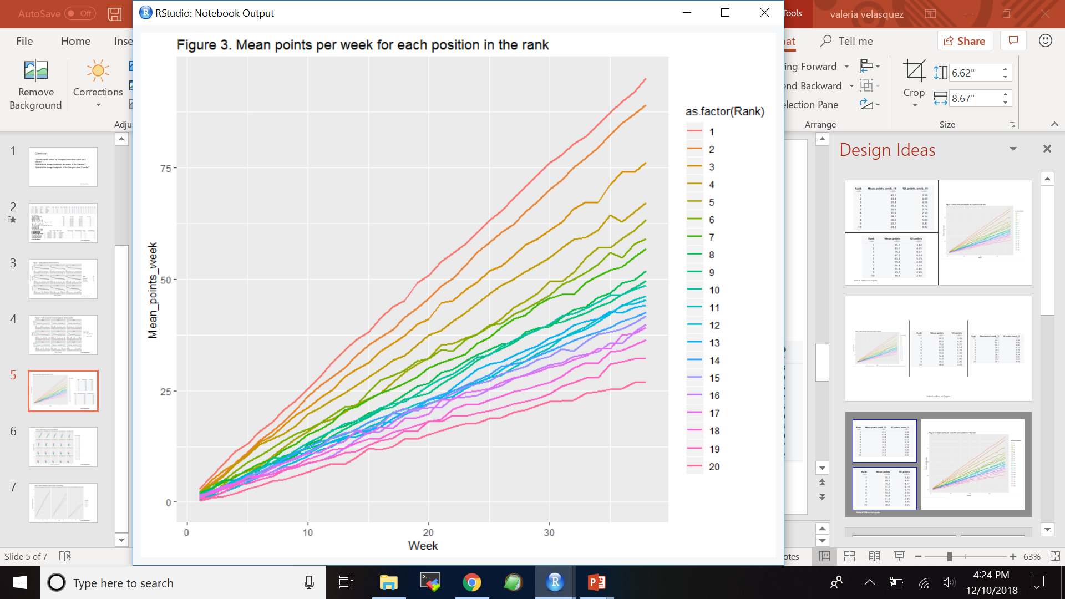

Slide 9
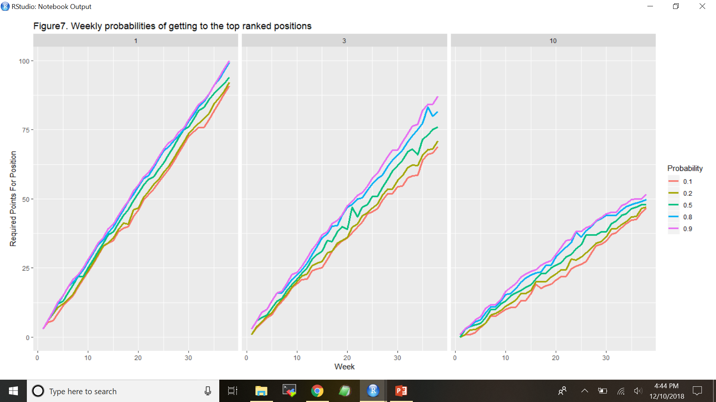

Slide 10
Conclusions
1) Barcelona is the best team in the league, having won 6 times, followed by Real Madrid (2 times) and Atletico de Madrid (1 time)
2) The middle-ranked positions have small differences between which makes them more difficult to predict
3) By half of the season there is a good idea of the top-ranked teams, since them have higher points/week rates throughout the whole season, making the differences with the rest larger every week

Slide 11
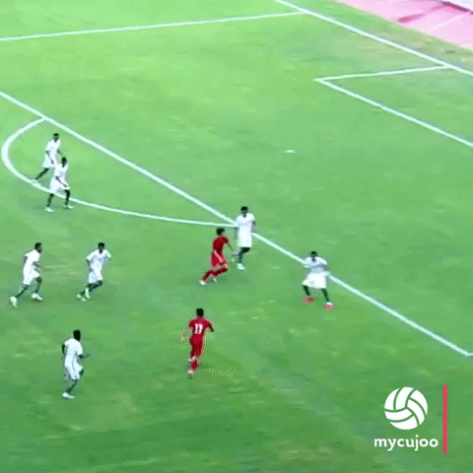
Offensive Style?
Rely on scoring goals

Slide 12
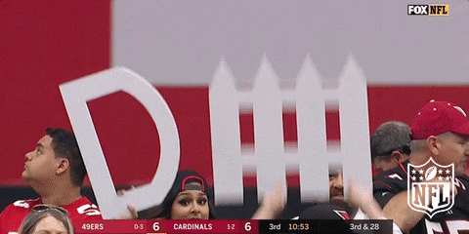
Defensive Style?
Receive less goals

Slide 13
Analysis of Offensive Style
Goals scored
Shots taken
Shots on target
Combined (not shown)
Averaged over 9 seasons
Individual seasons

Slide 14
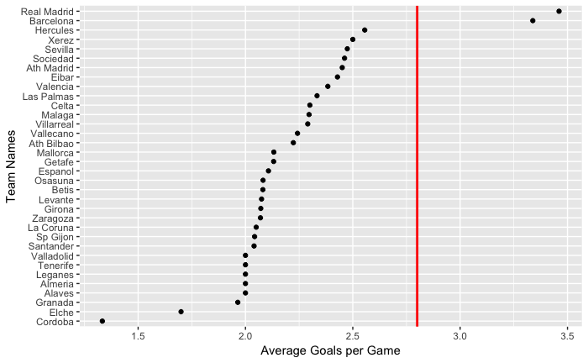
Scoring Goals – All
Real Madrid
Barcelona
2.8 Goals

Slide 15
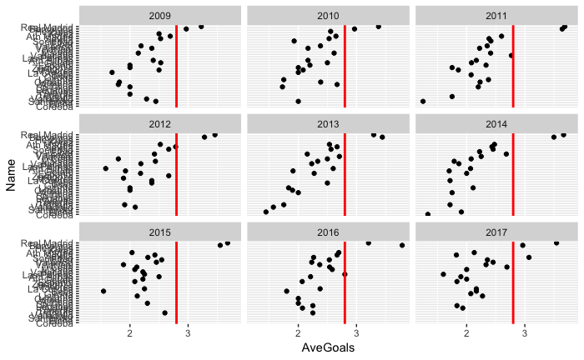
Scoring Goals – Individual
2.8 Goals

Slide 16
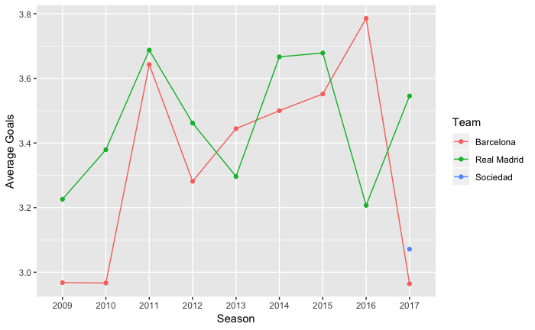
Scoring Goals – over 9 seasons
Real Madrid
Barcelona
Above 2.8 goals all 9 seasons

Slide 17
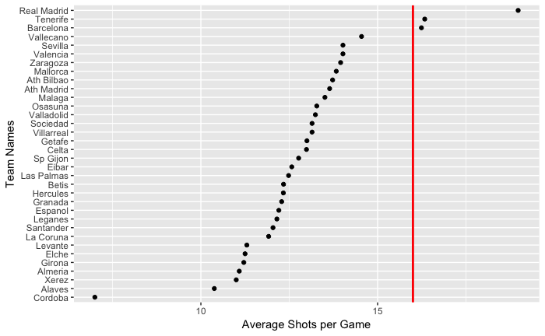
Shots Taken – All
Real Madrid
Tenerife
Barcelona
16 Shots

Slide 18
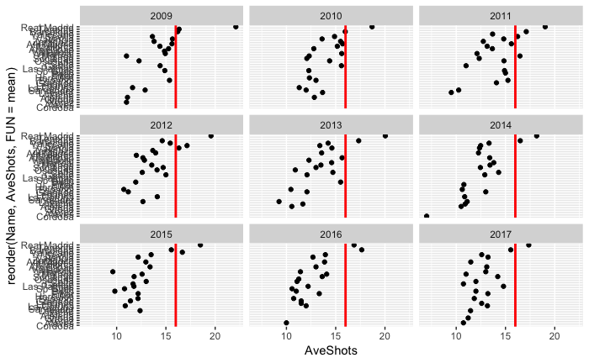
Shots Taken – Individual
16 Shots

Slide 19
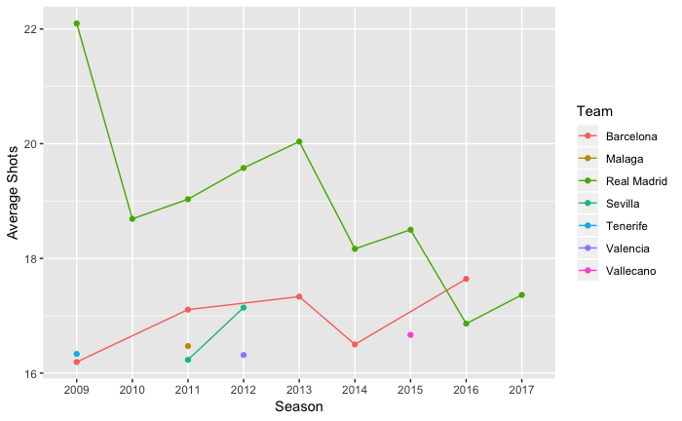
Shots Taken – over 9 seasons
Real Madrid
Above all 9 seasons
Barcelona
Above for 5 seasons

Slide 20
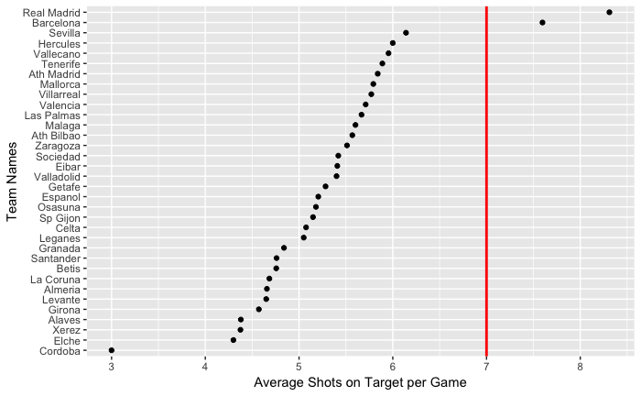
Shots on Target – All
Real Madrid
Barcelona
7 Shots on Target

Slide 21
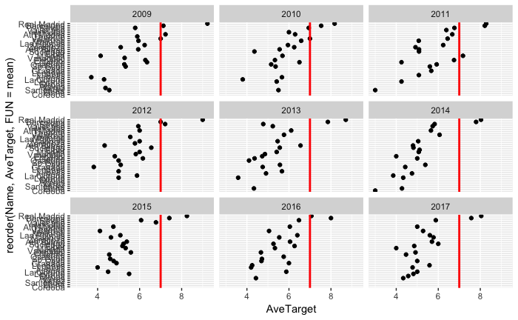
Shots on Target – Individual
7 Shots on Target

Slide 22
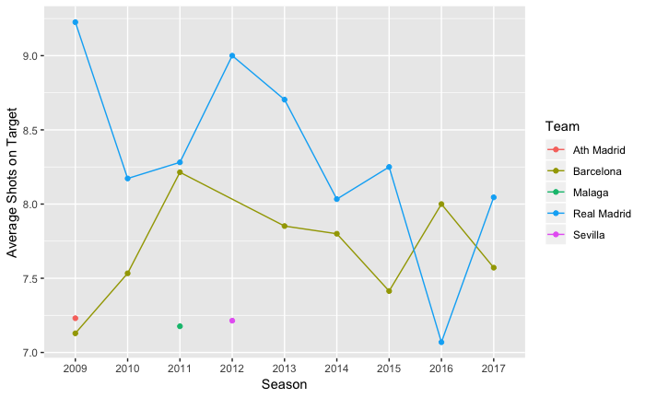
Shots on Target – over 9 seasons
Real Madrid
Above all 9 seasons
Barcelona
Above 8 seasons

Slide 23
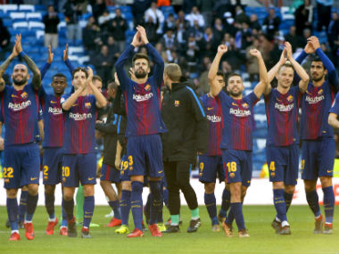
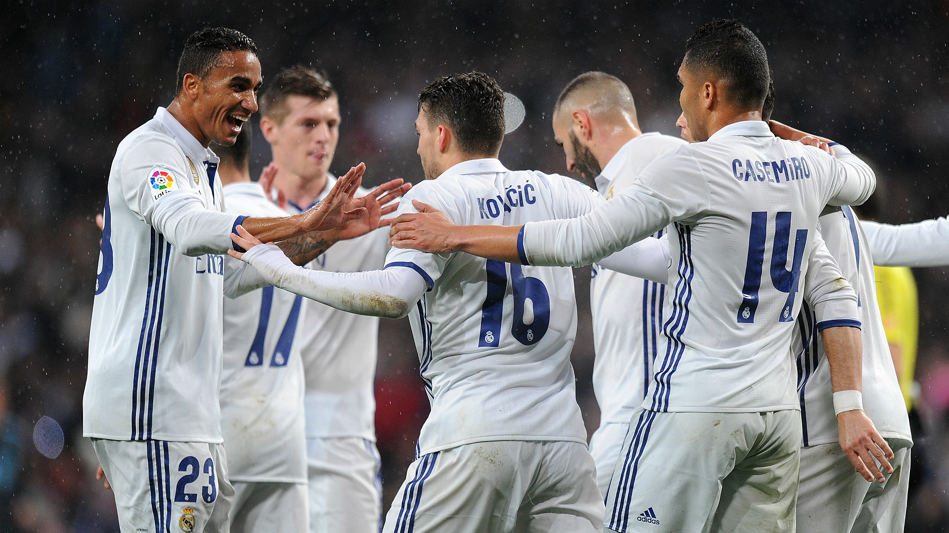
Conclusion for Offensive Playing
Real Madrid
Barcelona

Slide 24
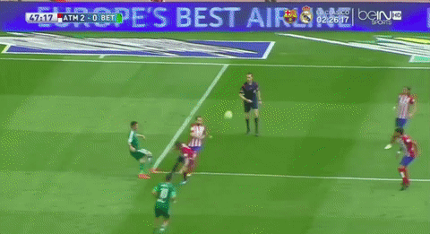
Analysis of Defensive Style
Goals received
Averaged over 9 seasons
Individual seasons

Slide 25
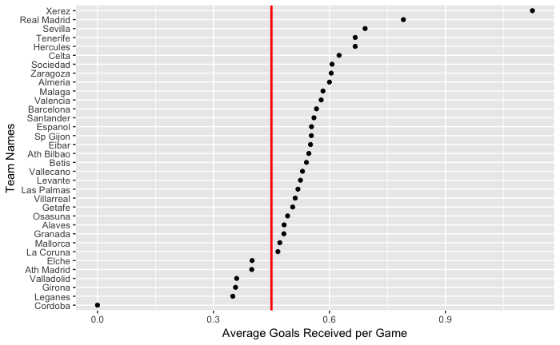
Goals Received – All
0.45 Goals Received
Ath Madrid
Didn’t play enough games

Slide 26
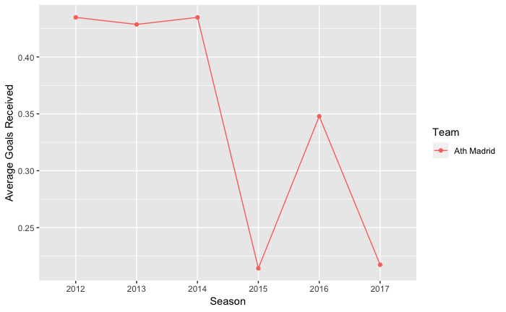
Goals Received – over 9 seasons
Ath Madrid
Below 6 seasons

Slide 27
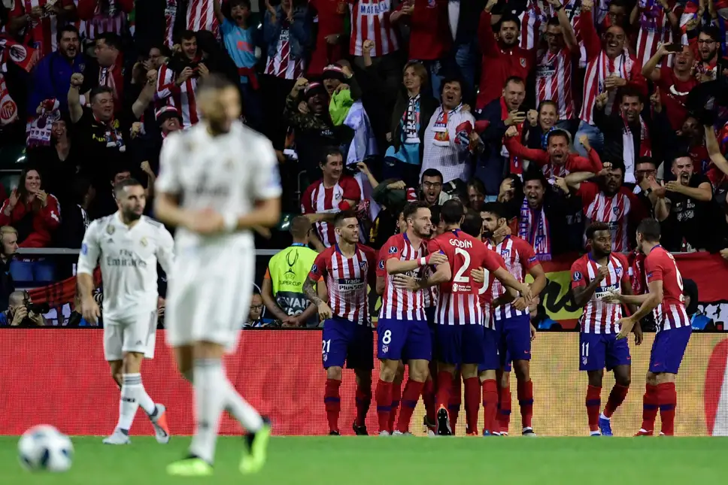
Conclusion for Defensive Playing
Atletico Madrid

Slide 28
WHICH TEAM WINS THE GAME?

Slide 29
PREDICTOR 1: PLAYING AT HOME VS AWAY

Slide 30
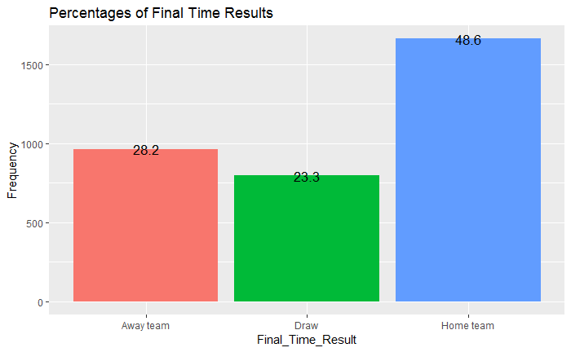
Home team has better chance in winning the game

Slide 31
PREDICTOR 2: HALF TIME RESULT

Slide 32
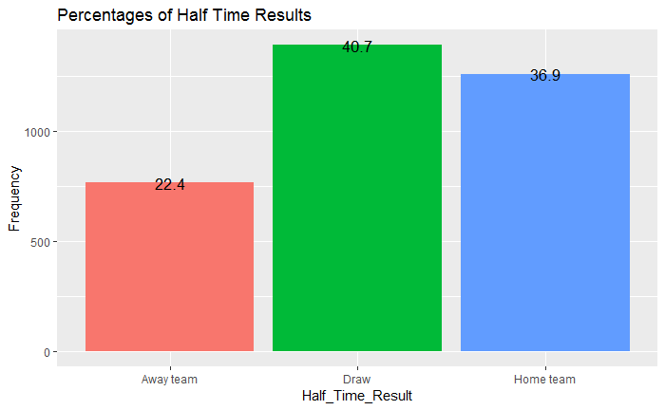
In 61.75 % of games, final time result is the same as the half time result

Slide 33
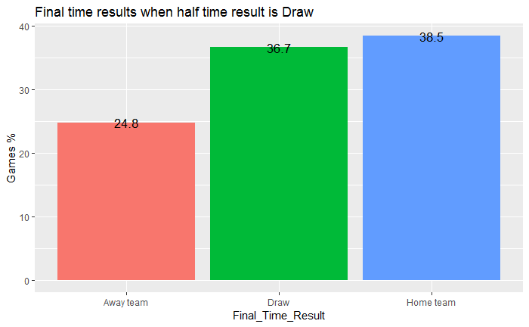
When the half time result is draw, final time result is different than the half time result in
63.3 % of the games

Slide 34
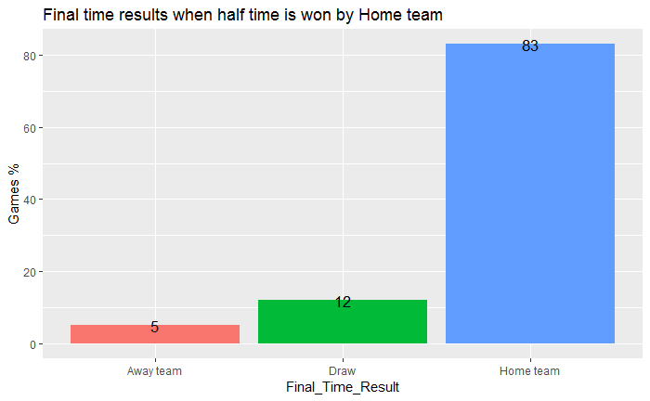
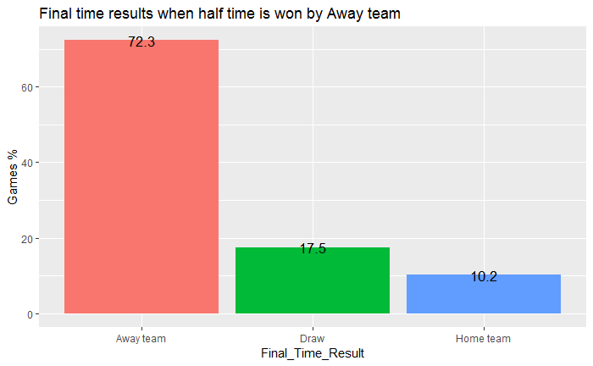
Home teams are better in keeping their winning results

Slide 35
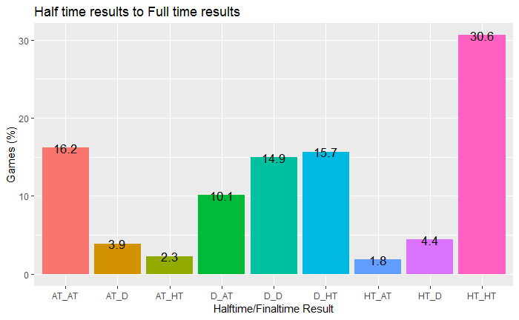

Slide 36
PREDICTOR 3: SCORE DIFFERENCE BY THE END OF HALF TIME
SCORE DIFFERENCE = NUMBER OF GOALS SCORED BY HOME TEAM –NUMBER OF GOALS SCORED BY AWAY TEAM

Slide 37
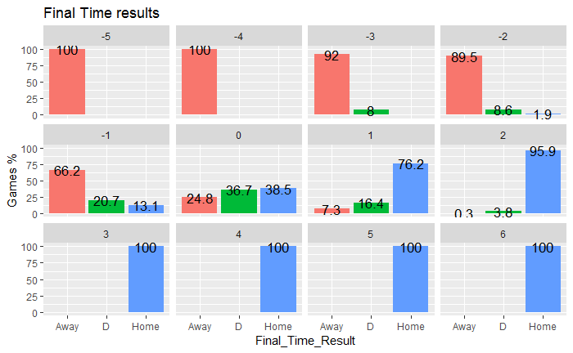

Slide 38
PREDICTOR 4: MORE SHOTS ON TARGET

Slide 39
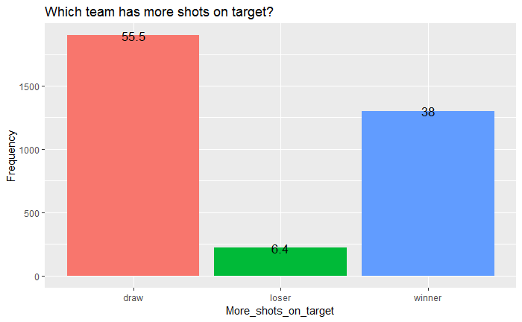
More shots on target does not necessarily result in winning the game

Slide 40
Thank you !

Slide 41
La Liga: Are scoring events and free and corner kicks associated?
STAT 579
James Klimavicz

Slide 42
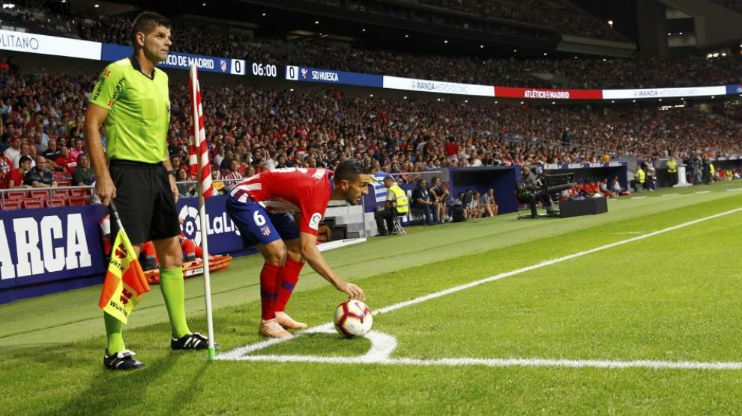
Association of free/corner kicks and goals
James Klimavicz
Free and corner kicks are chances to strategize
More kicking chances may increase scoring

Slide 43
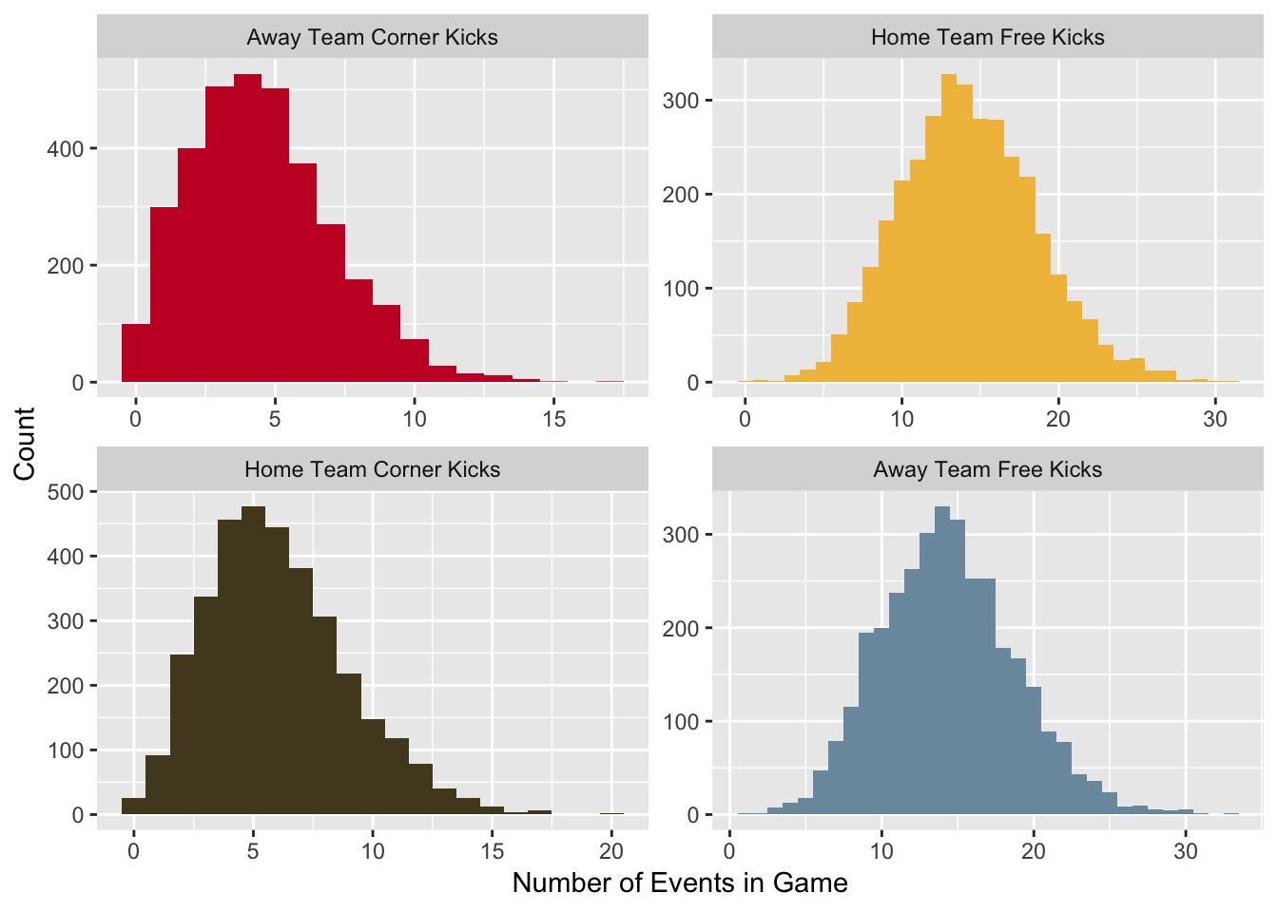
Counts of Kicking Events
James Klimavicz

Slide 44
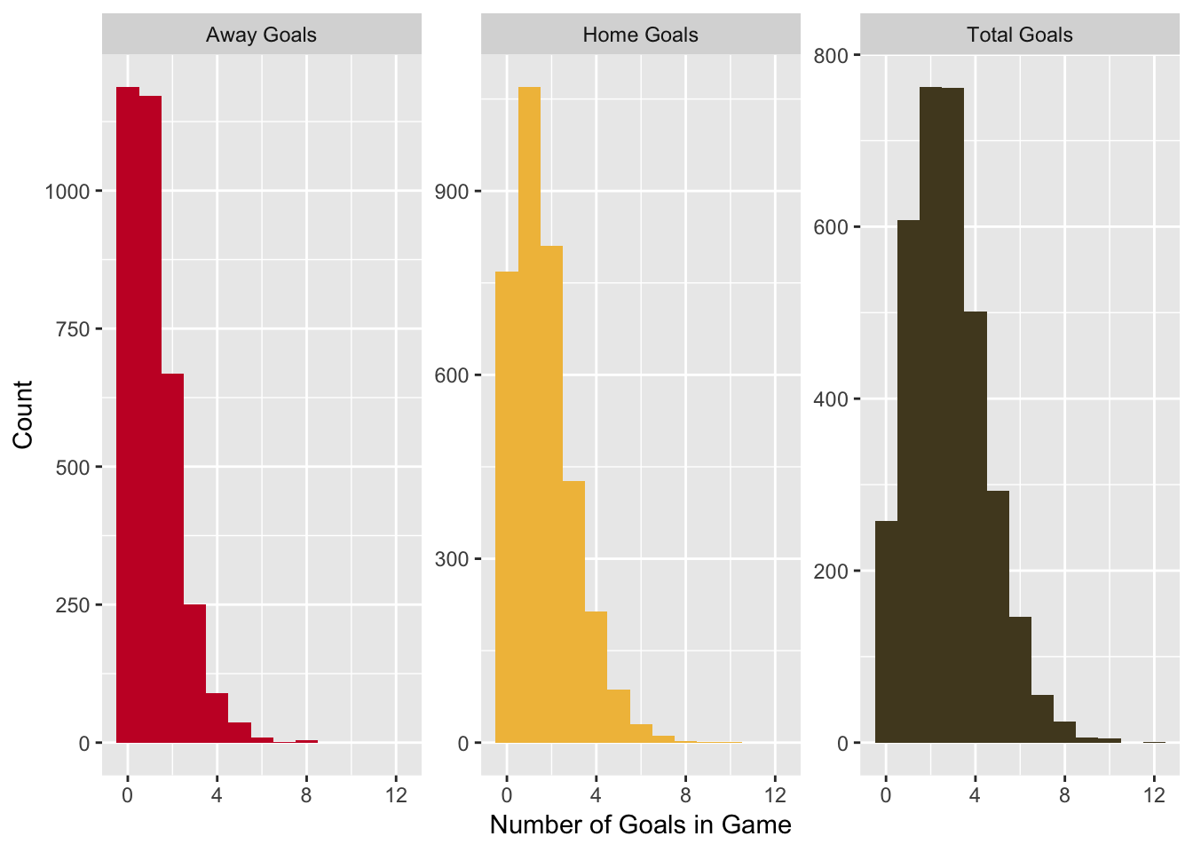
Counts of Goals
James Klimavicz

Slide 45
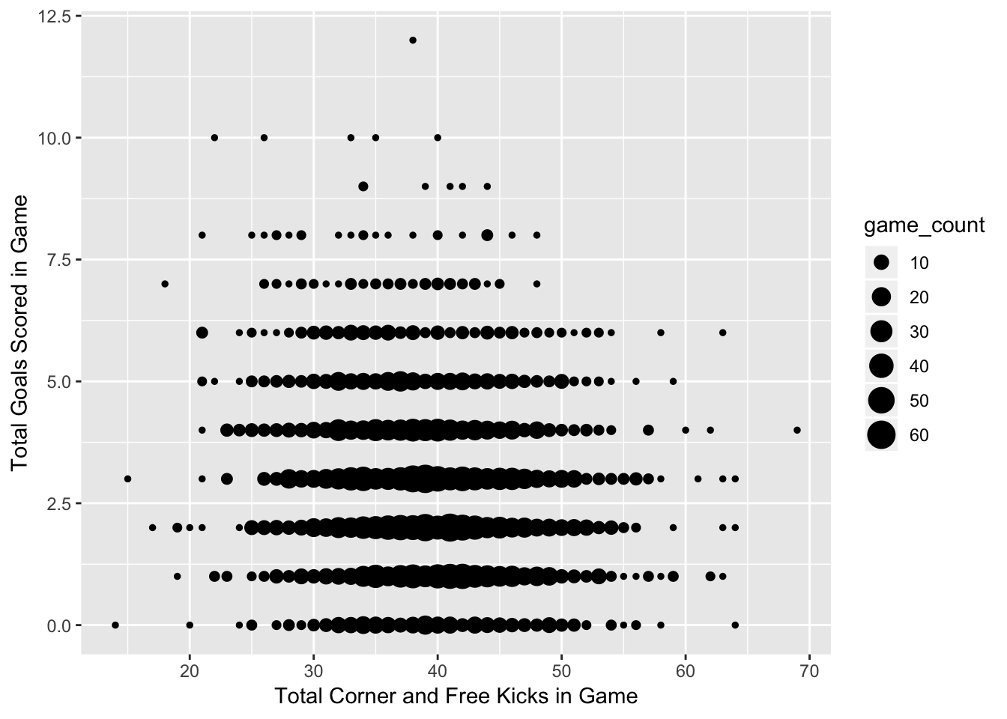
Association of All Kicks and All Goals
James Klimavicz

Slide 46
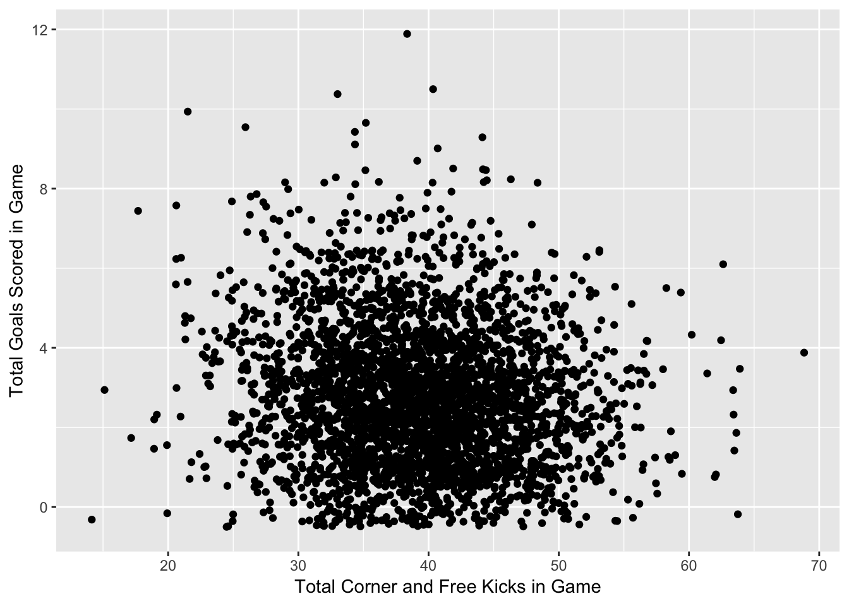
Association of All Kicks and All Goals
James Klimavicz

Slide 47
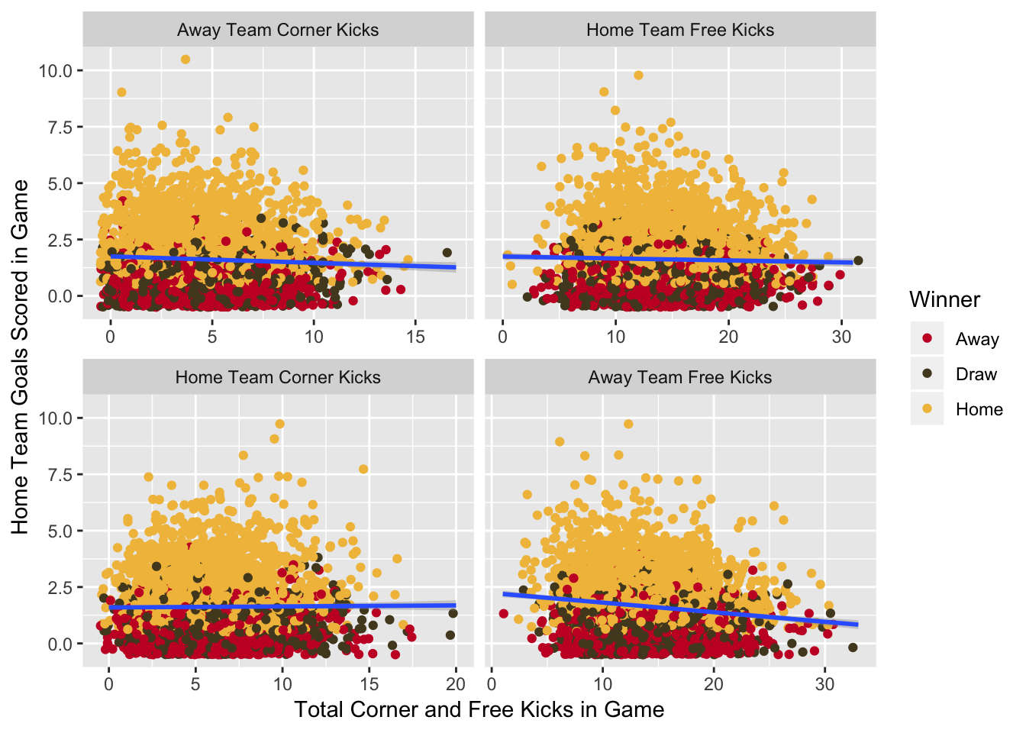
Correlation of Home Goals with Kicks
James Klimavicz

Slide 48
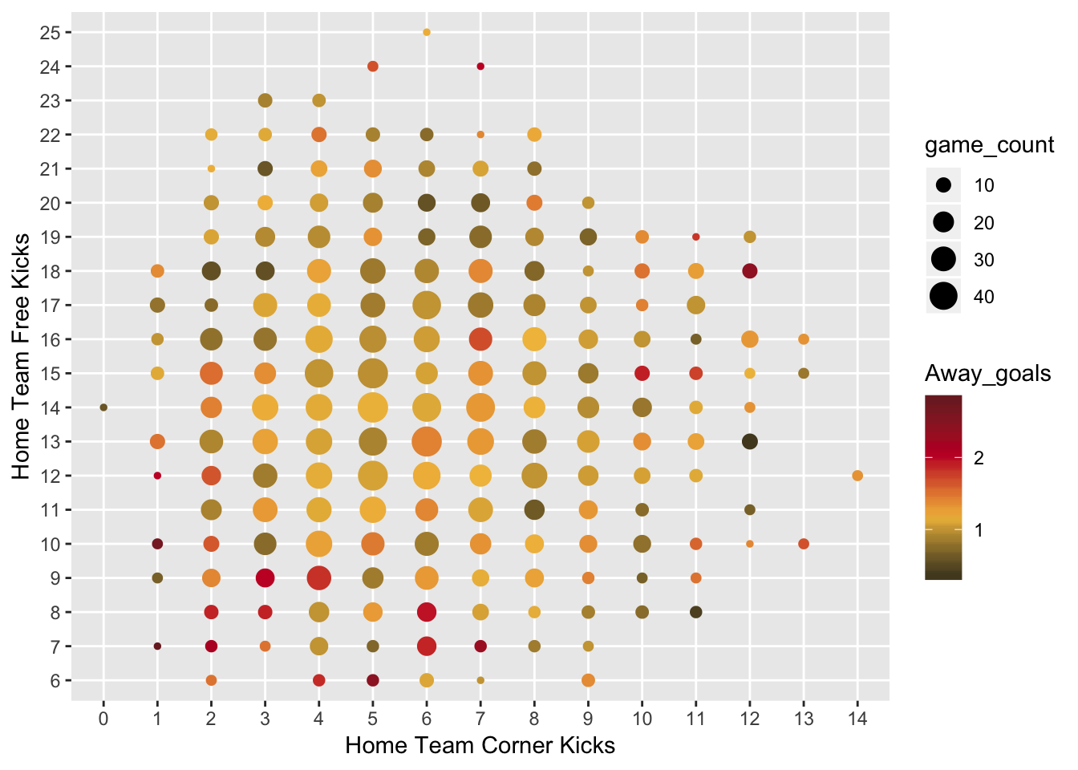
Away Team Goals
James Klimavicz

Slide 49
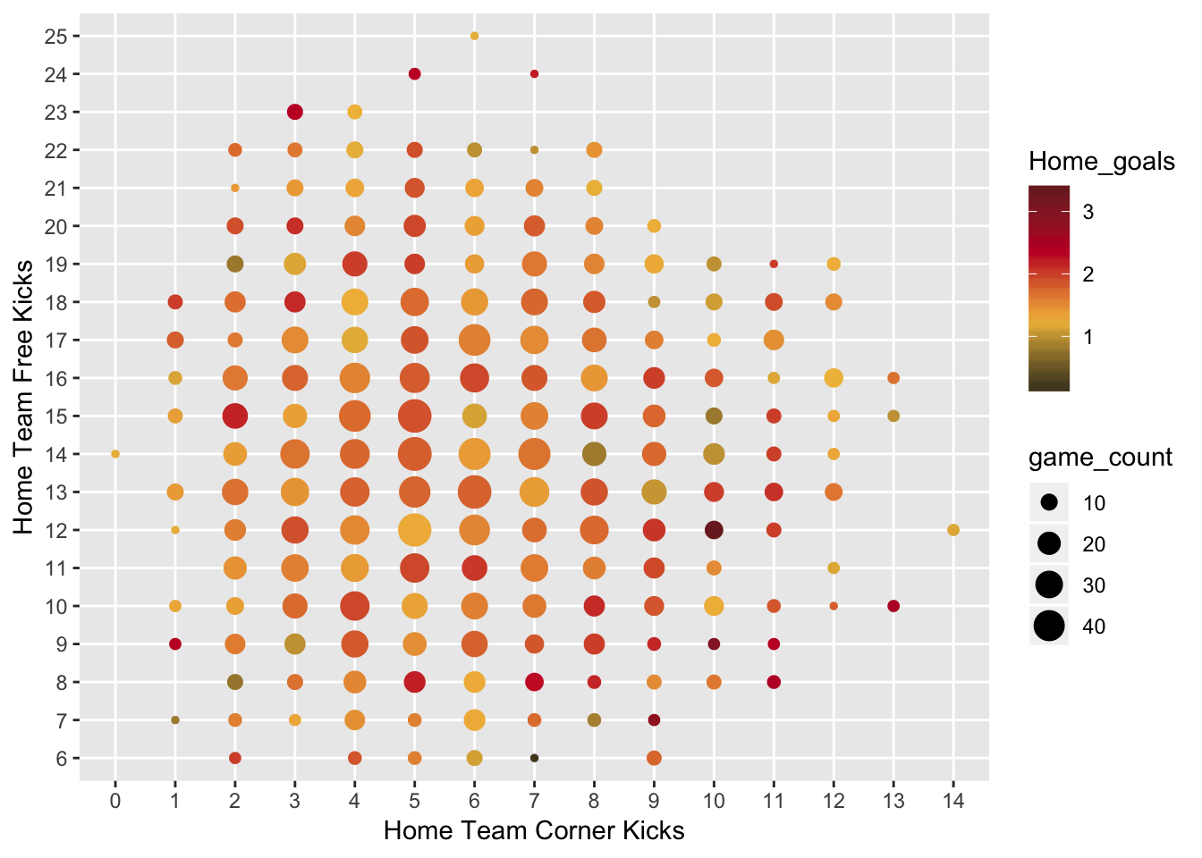
Home Team Goals
James Klimavicz

Slide 50
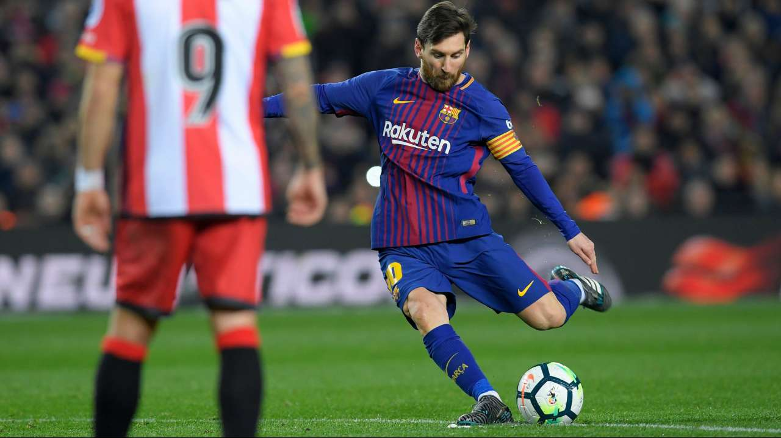
Conclusions
James Klimavicz
Correlation between kicks and goals is very small
More free kicks tend to produce lower scores
Causal effect cannot be established

Slide 51
When a team get a red card: a) does it imply the team will lose? b) is the goal difference larger?
Mauricio Serrano

Slide 52
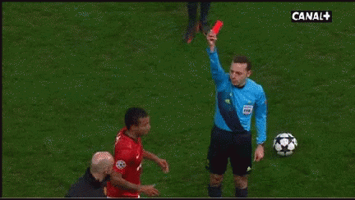
What is a red card?
The player is kicked out of the game.
Disadvantage for the team.

Slide 53
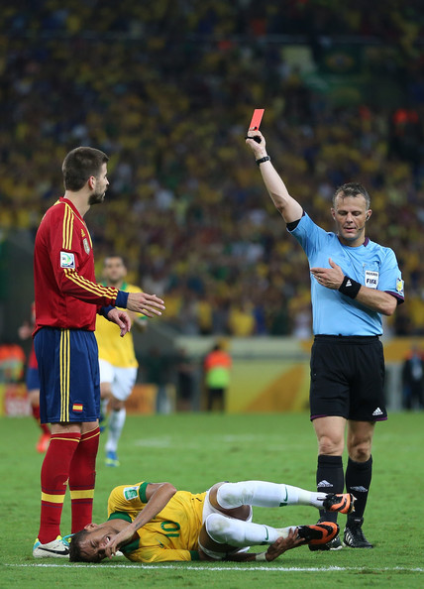
When a team get a red card
a) does it imply the team will lose?
b) is the goal difference larger than the goal difference in games without red cards?

Slide 54
Home
Red
Away
Red
No red
Red_draw
Red_win
Red_lose
ifelse()
Goal difference
abs()
Red
No Red
ifelse()

Slide 55
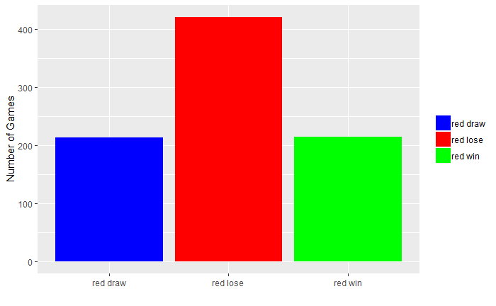
Games – Red card_result

Slide 56
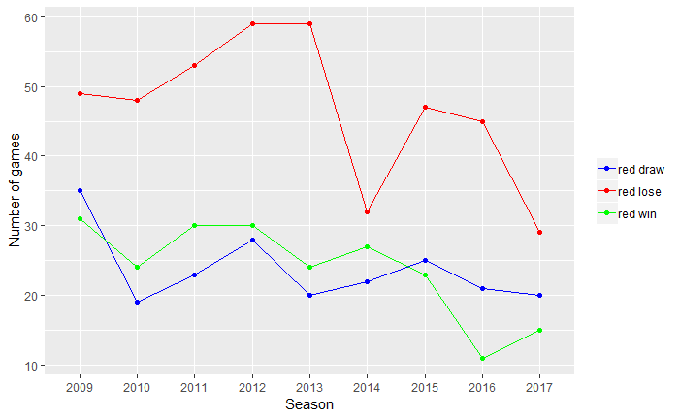
Games with Red cards – Over 9 seasons

Slide 57
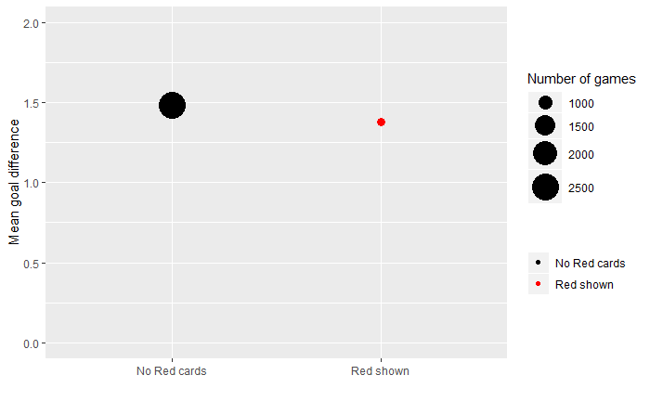
Goal difference – No Red card vs Red card

Slide 58
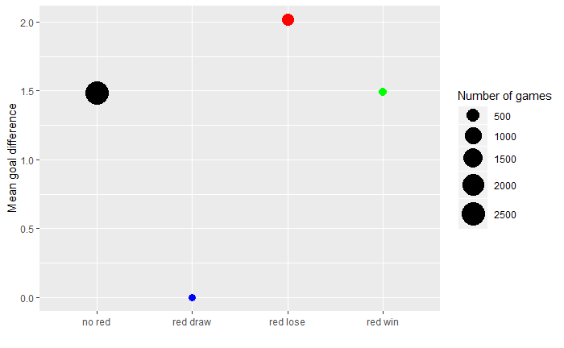
Goal difference – No Red card vs Red card_result

Slide 59
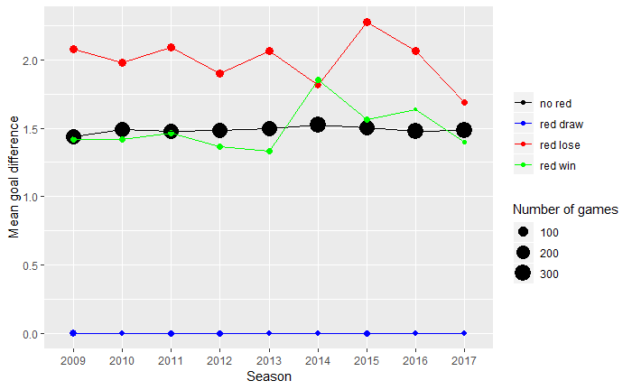
Goal difference and Red cards – Over 9 seasons

Slide 60
Conclusions
When a red card is shown, the team has higher chances to lose the game. This trend is consistent over seasons.
The mean goal difference is similar in games with and without a red card shown.
The mean goal difference is larger when a red card is shown and the team lose the game. This trend is consistent over seasons except in 2014.

Slide 61
Questions?

